Slide 1
WELCOME TO MY Nutritional home
Atalaya Hudson
Research for Kaplan University
PLEASE ENJOY THE PRESENTATION

Slide 2
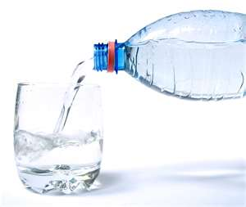
Water
The Overlooked Essential Nutrient

Slide 3
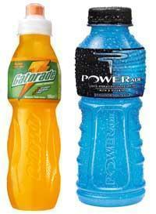
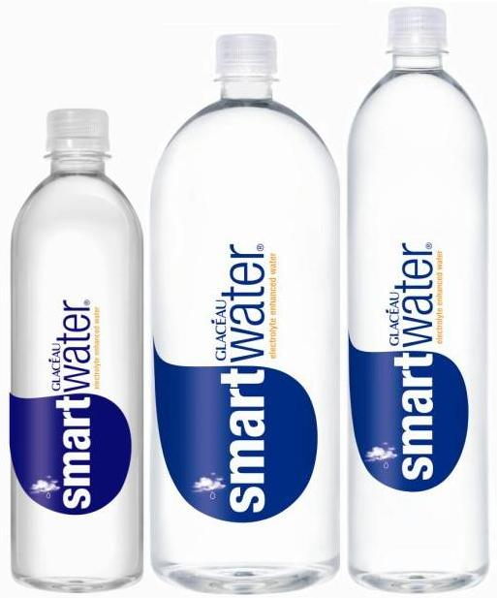
Discussion topics:
Daily recommendations
Recommendations
6. Nutrient content
Varieties/sources
. Advantages
Disadvantages
Safety levels
CONCLUSION

Slide 4
Hydration is an important part of proper physical activity, especially in hot climates where fluids and electrolytes are lost through sweat as a means of regulating body temperature. The amount of fluid that needs to be replaced depends on the individual, and the degree of activity. Failure to replace the fluids lost from sweat results in dehydration, which can lead to harmful weight loss, as well as dysfunction of the body's regulatory systems. Water and Gatorade aid in hydrating the body (Wellness goods , 2012).
Daily Recommendation
The Institute of Medicine suggests that men consume around 13 cups of total fluids a day and women consume about 9 cups, which includes water from other beverages as well as high-water containing foods.

Slide 5
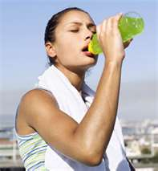
Nutritional Content
Water is recommended to aid in hydration before, during and after participating in physical activity to keep the body in balance ( Wellness goods, 2012). Sports drinks are generally preferred over water only when exercising at a high intensity, for a long duration of time and/or in high temperatures. Additionally, when participating in vigorous exercise, a carbohydrate drink, like Gatorade, helps replace glycogen stores lost during exercise.

Slide 6
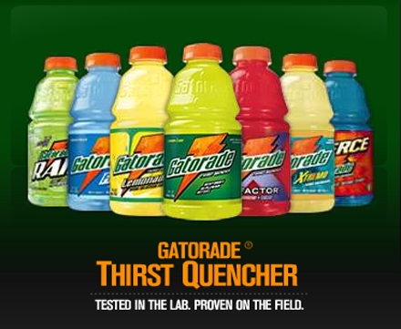
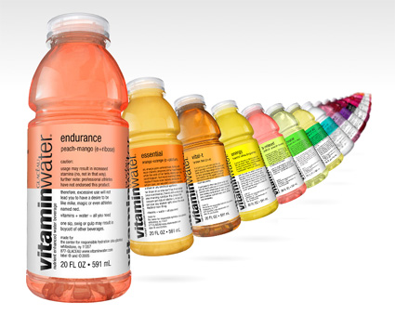
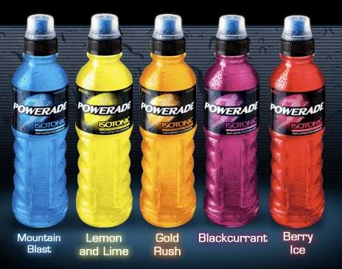
Sports drinks are not for everyone, and not for regular consumption outside of vigorous physical activity. For example, a 30-minute walk is an excellent cardiovascular activity, but does not require drinking a sports drink such as Gatorade afterwards. In this case, drinking water will suffice. However, for those who engage in more vigorous activity for an extended period of time, such as playing a soccer game, drinking Gatorade is an excellent way to replenish lost fluids and electrolytes (G Series ,2011).

Slide 7
Water is a bargain. The average price of water in the United States is about $1.50 for 1,000 gallons. At that price, a gallon of water costs less than one penny.
The ADVANTAGES
of Sports Drinks- vs- Water Replacing Fluids - The most common reason athletes and active adults drink sports energy drinks is because they have been exercising and sweating for a while. Through sweat, the body can lose a great deal of vitamins and fluids that are essential for proper functioning. By chugging a Gatorade of PowerAde, you can replenish your body with many of these vitamins. (G Series, 2011).

Slide 8
DISADVANTAGES
A typical sports drink can cost between $1.50-2.50 at your local convenience store or grocery store.
Many sports drinks also contain high amounts of protein. According to the Athleteinme.com website, athletes who consume drinks that contain carbohydrates combined with protein perform much better when exercising than athletes that drank fluids that only had carbohydrates ( Ehow, 2012).
4-18 percent of the 173 bottled waters on the U.S. market today fail to list the location of their source; a third disclose nothing about the treatment or purity of the water inside their plastic bottles ( Ehow, 2012).

Slide 9
SAFETY LEVELS
Bottled water is generally safe, but only in sealed, tamper-proof containers.
Bottled water comes from many different Countries, so be care. Make sure its been tested or approved by the Water Control Board. Prolonged exposure to higher temperatures will kill many parasites. Drinking from a hot water bottle is slightly safer than drinking untreated cold water ( Ehow (2012).
The concentration of sugar in a sports drink is recommended to be 6-7% carbohydrate to allow maximum absorption and minimize spikes and crashes in blood sugar. Higher concentrations such as those seen in energy drinks increase the possibility of dehydration. (Ehow (2012).

Slide 10
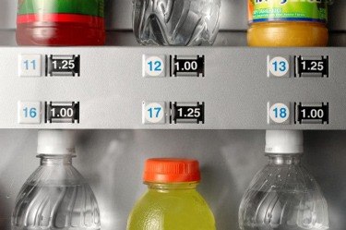
Athletes have a choice of fluids, including different types of water and sports drinks, each offering different benefits. Good drinking water, such as mineral water or spring water, contains essential minerals that replace those lost through sweat, helping to maintain the body’s natural balance.
Sports drinks don't hydrate better than water, but you are more likely to drink larger volumes, which leads to better hydration. Let’s not forget the fact that water is cheaper than most sports drinks, so consumer will flock to purchase water first ( G Series, 2011).
Bottled Water that contains electrolytes, Like Smart Water Products are best for the body, because they aid, replenish, and give you energy. (G Series, 2011).
CONCLUSION

Slide 11
REFERENCES
1. Wellness goods (2012). Why is water so important? (2011) Retrieved on Wednesday, April 26, 2012, from : www.wellnessgoods.com/waterimportant.asp
2. Ehow (2012). How Does PH Affect Drinking Water (2012) Retrieved on Wednesday, April 26, 2012, from: eHow.com http://www.ehow.com/how-does_5125222_ph-affect-drinking-water.html#ixzz1t7PoVcR5
3. G Series (2011). Prime Get The Pre-Game Fuel You Need To Start Strong With G Series Prime. Retrieved on Wednesday, April 26, 2012, from Gatorade.com/GSeriesPrime
4. Ehow(2012). Safe Water Levels for Drinking Retrieved on April 25, 2012 from http://www.ehow.com/facts_7441670_safe-water-levels-drinking.html#ixzz1tbKplFPf

